Slide 1














Product-Market Fit Analytics using Big Data Processing with PySpark
CD19651 : Mini-Project
Presented by
: V Rishabh (211701044)

Slide 2

Problem Statement
To assist a prospective entrant into the e-commerce marketplace in identifying the optimal product-market fit, this project aims to leverage PySpark for big data analytics. The goal is to process large volumes of user data from various sources and create insightful visualizations and dashboards.
By doing so, the project seeks to provide data-driven recommendations on the types of products that align with market demands and consumer preferences, ultimately guiding the client's investment decisions.

Slide 3
Proposed Technology & Solution
Data Processing and Integration:
Objective: Develop a robust data processing pipeline using PySpark instead of Pandas, etc. to efficiently collect, clean, and integrate diverse data sources related to market trends, user behavior, and competitor analysis.
Key Results: Achieve a streamlined data processing workflow that ensures data accuracy, completeness, and timeliness, enabling comprehensive insights into the e-commerce landscape.

Slide 4
Proposed Technology & Solution
Product-Market Fit Recommendations:
Objective: Utilize the processed data to generate actionable recommendations for the client regarding the optimal product-market fit. This includes identifying high-demand product categories, understanding consumer preferences, and offering insights into potential market niches.
Key Results: Provide the client with a set of well-documented and data-backed recommendations, supported by visualizations and analytics, to guide their investment decisions in manufacturing and selling products within the e-commerce marketplace.

Slide 5
Proposed Technology & Solution
Insightful Visualizations and Dashboards:
Objective: Create interactive and insightful visualizations and dashboards that translate the processed data into actionable insights. Focus on user-friendly interfaces that facilitate easy interpretation of complex analytics for non-technical stakeholders.
Key Results: Deliver visually compelling dashboards that effectively communicate trends, patterns, and correlations within the data, empowering the client to make informed decisions about potential product offerings.

Slide 6
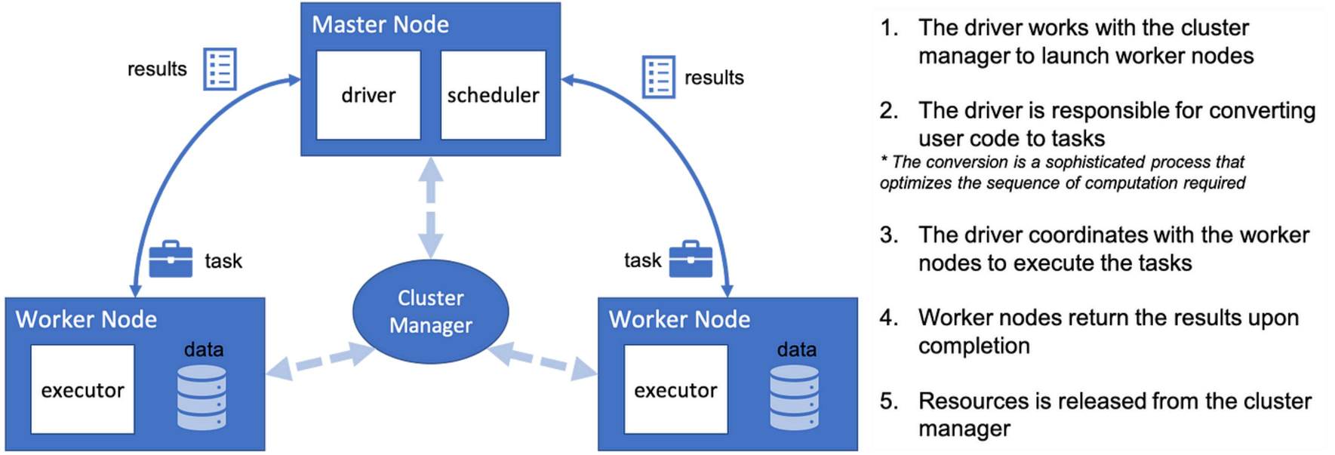
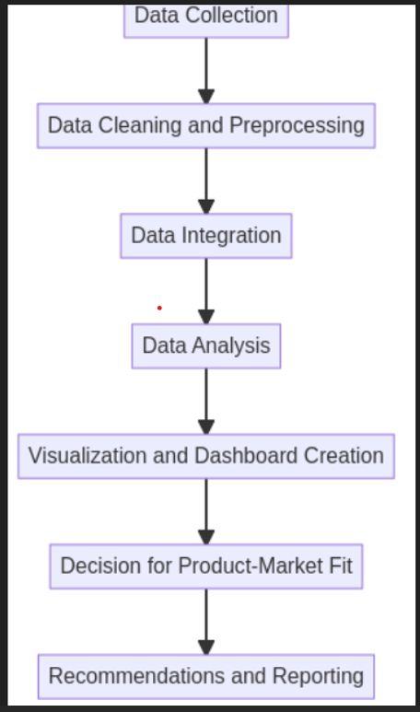
Relevant Diagrams

Slide 7

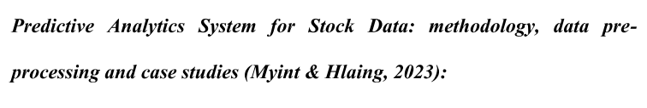
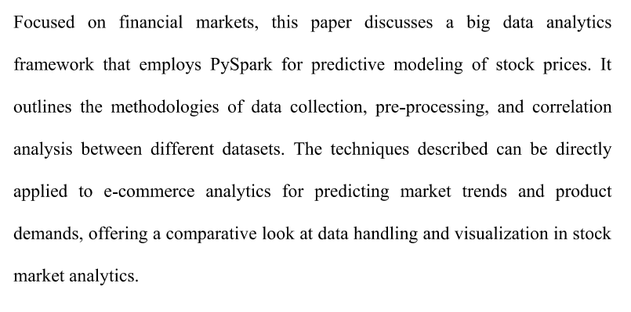
Research & Industry Perspectives

Slide 8
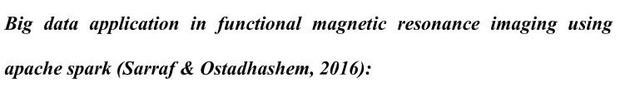

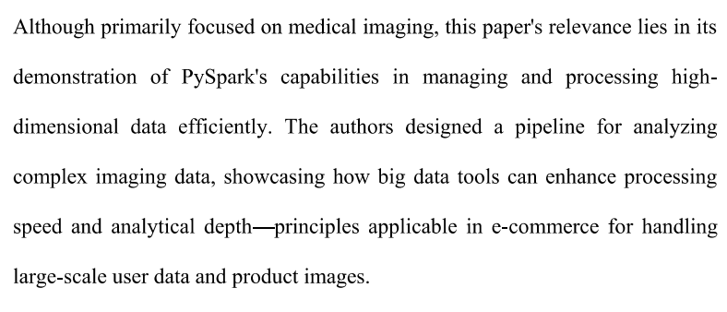
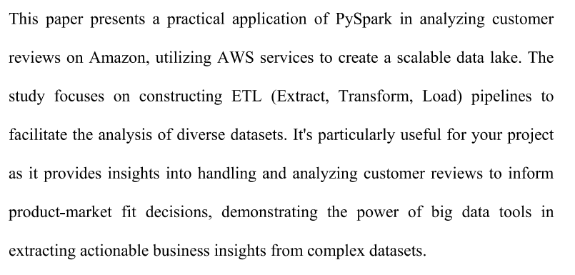
Research & Industry Perspectives

Slide 9

Final reflections and future steps
Deliver visually compelling dashboards that effectively communicate trends, patterns, and correlations within the data, empowering the client to make informed decisions about potential product offerings using PySpark.
We can also use GPUs and Large Language Models for novel data processing methods that can compete with the speed, scale and efficiency of PySpark.

Slide 10
Thank you very much!
www.reallygreatsite.com

